Slide 1
What is Fun?
Michael C. Neel

Slide 2

Xbox Live Community Games

Slide 3
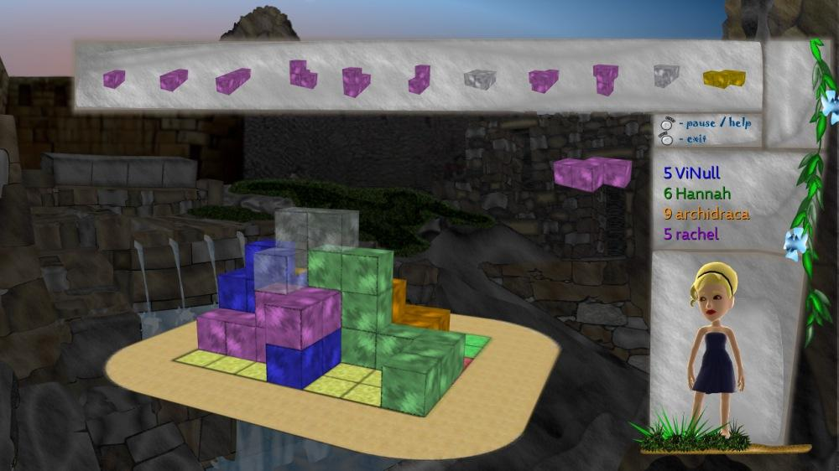
IncaBlocks

Slide 4
IncaBlocks RIP

Slide 5


Slide 6
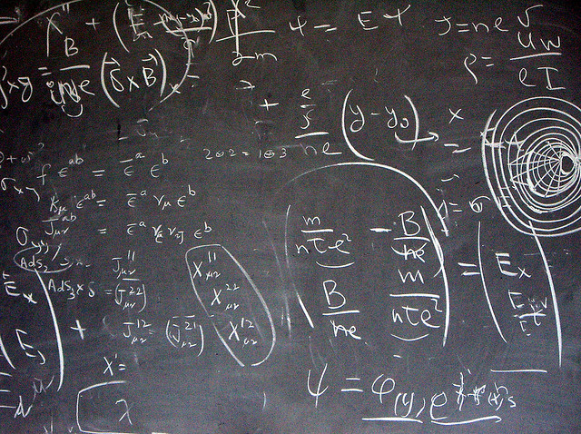
What is fun?
Notes:
http://www.flickr.com/photos/mscolly/145052885/

Slide 7

The Eureka Moment
Notes:
http://www.flickr.com/photos/wi2_photography/5578405780/

Slide 8
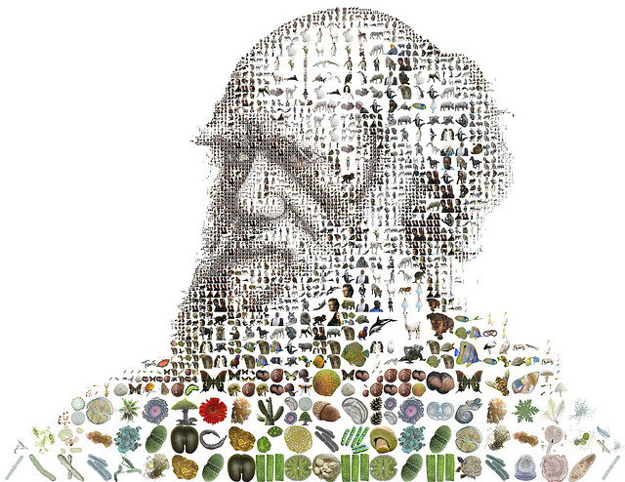
Evolution
Notes:
http://www.flickr.com/photos/tsevis/3288860652/

Slide 9
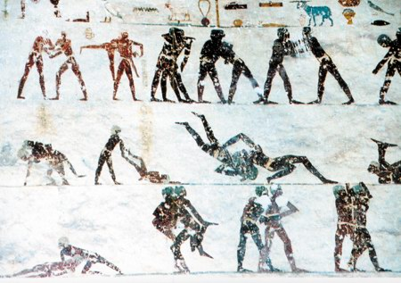
The First Games
Notes:
http://weekly.ahram.org.eg/2004/2010/sc72.htm

Slide 10

Games Teach
Notes:
http://www.flickr.com/photos/cybrarian77/6284181389/

Slide 11
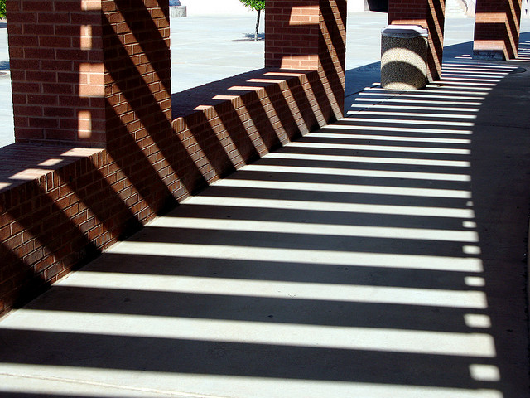
Understanding
Notes:
http://www.flickr.com/photos/pagedooley/2431908051/

Slide 12
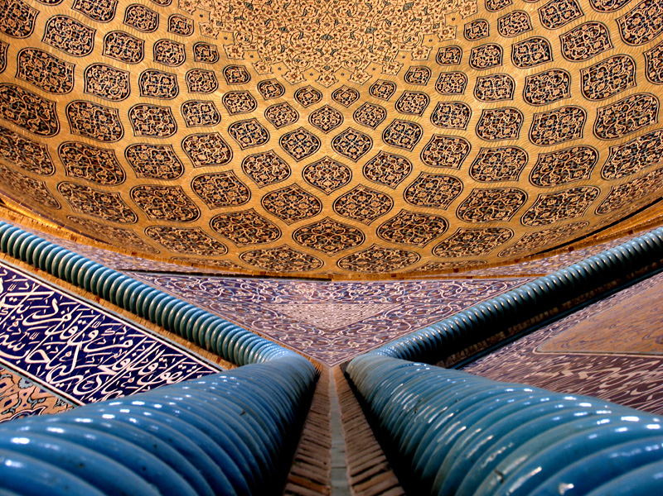
Small Change
Notes:
http://www.flickr.com/photos/horizon/155859533/

Slide 13
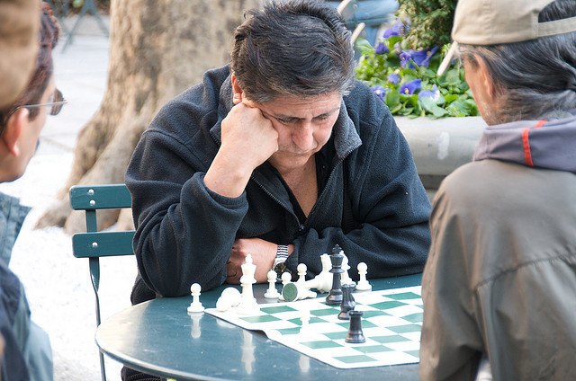
Small Change
Notes:
http://www.flickr.com/photos/yourdon/3405809406/

Slide 14
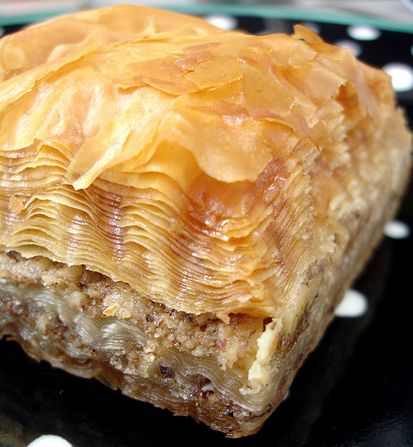
Small Change
Notes:
http://www.flickr.com/photos/bunchofpants/105966025/

Slide 15
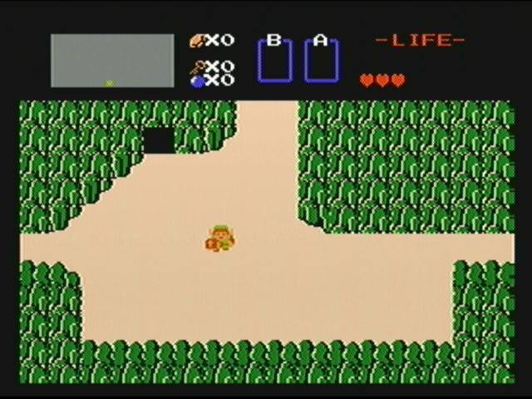
Link’s Small Change

Slide 16
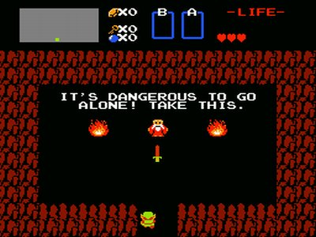
Link’s Small Change

Slide 17
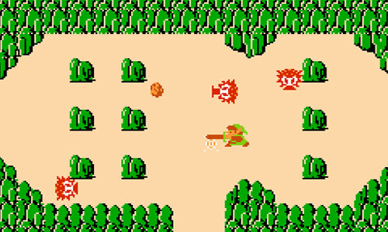
Link’s Small Change

Slide 18
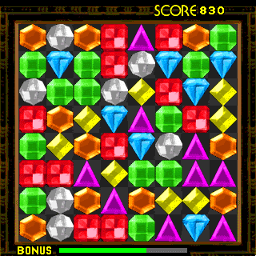
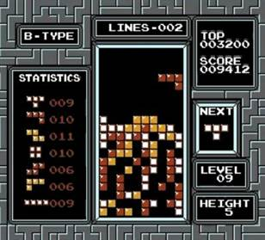

Change Over Genre

Slide 19
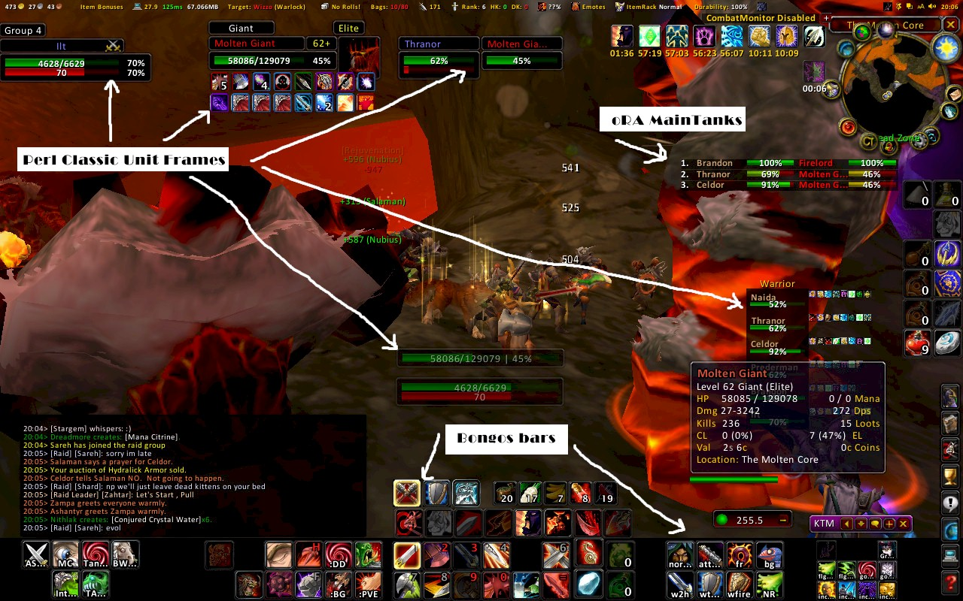
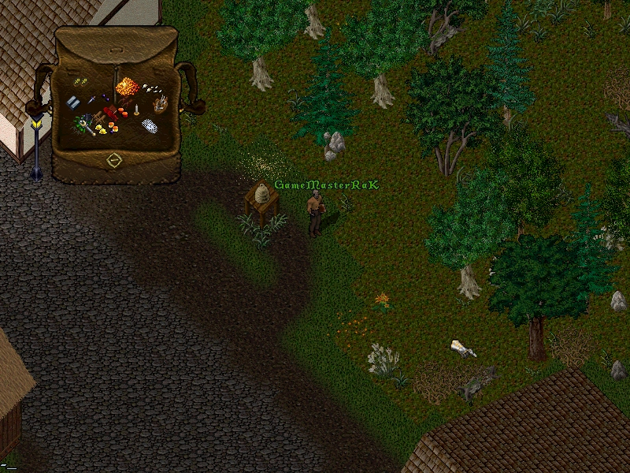
“Small” becomes “Big”

Slide 20


Expectations
1:20
0:00.7
0:02
Ben Cousins / Develop Magazine August 2002

Slide 21
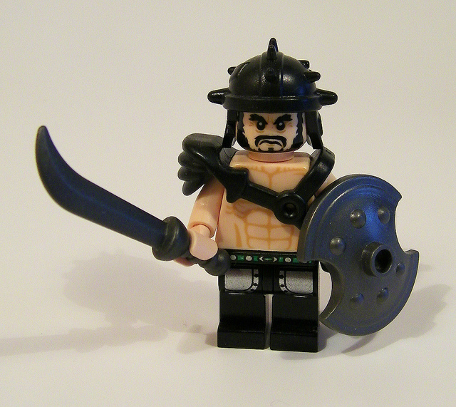
Empowerment
Notes:
http://www.flickr.com/photos/38446022@N00/6882523113/

Slide 22
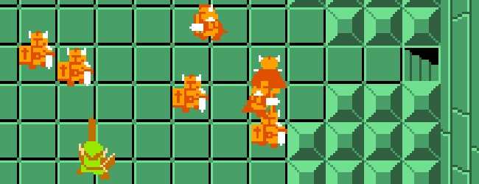
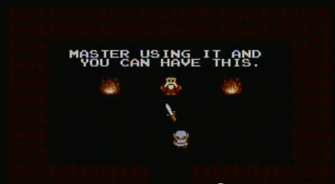
Zelda Darknut

Slide 23
Bejeweled Power Curve
Level | Points Needed | Match 3
1 - 2 | 500 | 10
2 - 3 | 1000 | 15
3 - 4 | 1500 | 20
4 - 5 | 2500 | 25
5 - 6 | 3300 | 30
6 - 7 | 4400 | 35
Notes:
Data by Extra Credits

Slide 24
Bejeweled Power Curve
Level | Points Needed | Match 3 | Difficulty
1 - 2 | 500 | 10 | 50
2 - 3 | 1000 | 15 | 67
3 - 4 | 1500 | 20 | 75
4 - 5 | 2500 | 25 | 100
5 - 6 | 3300 | 30 | 110
6 - 7 | 4400 | 35 | 126
Notes:
Data by Extra Credits

Slide 25
Bejeweled Power Curve
Level | Points Needed | Match 3 | Difficulty | Increase
1 - 2 | 500 | 10 | 50 | -
2 - 3 | 1000 | 15 | 67 | 17
3 - 4 | 1500 | 20 | 75 | 8
4 - 5 | 2500 | 25 | 100 | 25
5 - 6 | 3300 | 30 | 110 | 10
6 - 7 | 4400 | 35 | 126 | 16
Notes:
Data by Extra Credits

Slide 26
Bejeweled Power Curve
Notes:
Data by Extra Credits

Slide 27

Reward
Notes:
http://www.flickr.com/photos/photography-andreas/5353761255/

Slide 28
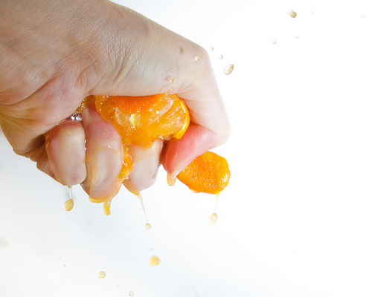
Reward
Notes:
http://www.flickr.com/photos/dolmansaxlil/5347064183/

Slide 29

Empowerment + Reward
Notes:
Image from Doctor Who

Slide 30


Empowerment + Reward

Slide 31
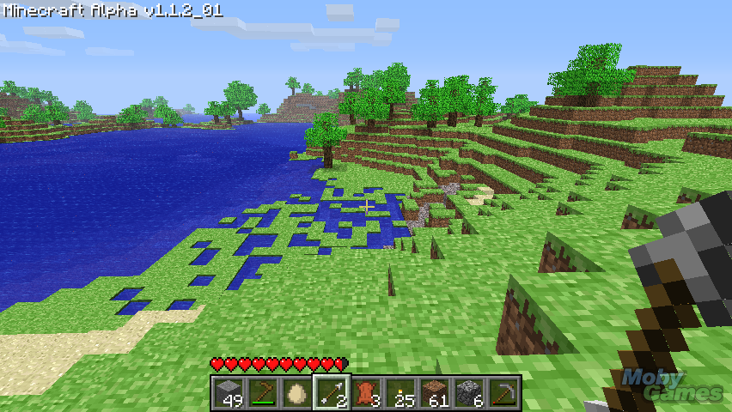
Exploration
Notes:
Minecraft

Slide 32
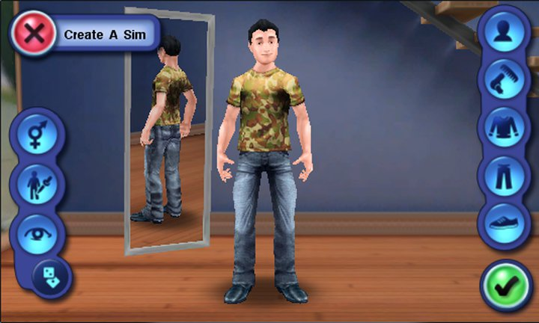
Personalization
Notes:
Mass Effect 3

Slide 33
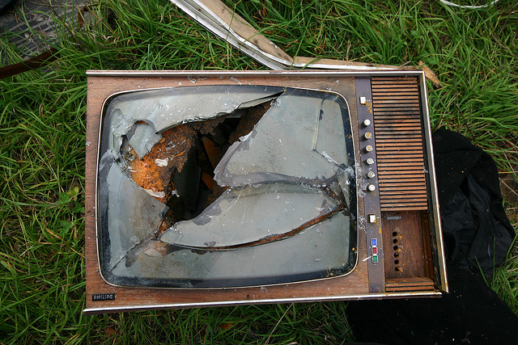
Decoding Feedback
Notes:
http://www.flickr.com/photos/schmilblick/252772357/

Slide 34



Further Reading…

Slide 35
What is Fun?
Michael C. Neel
michael.neel@gmail.com / @ViNull
vinull.com / gamemarx.com

